Slide 1
Machine Translation
Alejandro Ciuba
Based on a presentation by Steve Sloto
LING1330 – Introduction to Computational Linguistics
December 1st, 2022

Slide 2
Overview
Historical Overview
Early models to the modern day
Different approaches – Rules-Based vs. Statistical
Corpora types – Parallel, Monolingual, Dictionaries
Important Concepts in Machine Translation
Accuracy measurements
Neural Networks Overview
Back propagation
One-hot vector encoding
Perceptron/FFNN, Encoder-Decoder, RNN/GRU/LSTM, Transformers
Pros & Cons of Neural Network Translations
Recent Research
Public-Facing APIs for Machine Learning and Translation
PyTorch & Hugging Face

Slide 3
Historical Overview

Slide 4
Historical Overview – The Early Days
Rule-based Machine Translation
Follow a series of deterministic rules which produce a translation
Rules were hand-made to each language pair
IBM 701 Translator (1954) – Used 6 rules to translate between Russian and English
Assume 1:1 equivalence
Swap words if there is a difference in word order.
Choose target word(s) based on indication in the following source word
Choose target word(s) based on indication in the previous source word
Omit source words that should not appear in the target translation
Add target words that do not appear in the source, but should appear in the target
Dostert – "Five, perhaps three years hence, interlingual meaning conversion by electronic process in important functional areas of several languages may well be an accomplished fact.”
Notes:
- What’s wrong with the ruleset? - Léon Dostert (May 14, 1904 – September 1, 1971) was a French-born American scholar of languages and a pivotal proponent of machine translation.

Slide 5
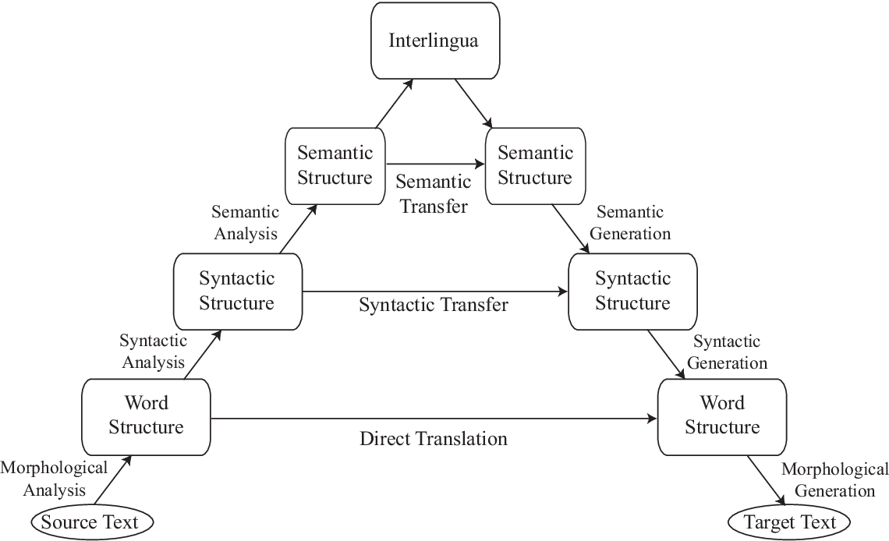
Historical Overview – Interlingua
Notes:
- From source text to target text; The higher linguistic level concepts you consider during translation, the closer you get to an “interlingua” or 1:1 translation between the two languages.
- Do you think this is possible?

Slide 6
Historical Overview – The Long Reign of Statistics
Concept: Look at parallel corpora to determine what should be translated statistically
Parallel Corpus: A corpus containing sentence pairs; translations of a sentence
Ex. Tamasheq-English-French
Monolingual Corpus: A corpus containing only sentences/words from one language
Worked via Bayes’ Theorem
P(T | S) = P(Target text given the source text) = P(S | T) * P(T) = P(source given target) * P(target)
This was called The Translation Table
Also considered things like word-alignment (e.g. “todos los días” -> “every day”) and word reordering
All these things were given weight and then considered when producing a translation
Notes:
- Tamasheq-English-French is the parallel corpus I made during my research over the Summer
- Denominator not considered
- P(T) was given by a monolingual corpus

Slide 7
Historical Overview – The Rise of a New Approach
Statistics-based machine translation became the de facto technique for many many years
Even as recently as 2015, companies like Ali Express were using statistics-based models for translation!
Neural Networks also had some popularity
Recurrent Neural Networks & Encoder-Decoder Models
Google Translate became a neural model in November 2016
Improved zero-shot translation – Translating without an intermediate language
Something happened however on June 12th, 2017…
More on this later!

Slide 8
Important Concepts in Machine Translation

Slide 9
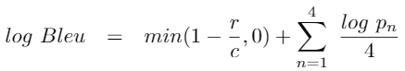
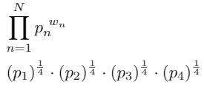
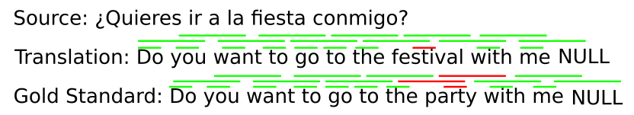
Important Concepts – Basic Measurements
There are a few ways researchers measure the “accuracy” of a translation
Can change between project goals, modality (spoken vs. written), and system-design
BLEU (BiLingual Evaluation Understudy): (The most common measure)
Compares n-grams of human-translated gold standard texts to the model’s output
The math:
Geometric Mean Sum of n-gram precision (1-4)
Brevity Penalty
Notes:
- What’s wrong with the ruleset? - Léon Dostert (May 14, 1904 – September 1, 1971) was a French-born American scholar of languages and a pivotal proponent of machine translation.

Slide 10

Important Concepts – Basic Measurements Cont.
BLEU is good for non-code-switched one-to-one translations, but has drawbacks
Based around a human-translated translations
Bias in translator style, subject, skill-level, etc.
Mostly text-based and unsuitable for code-switched texts
Word Accuracy/Word Error Rate are more common for voice-based systems
Word Accuracy = 1 - WER
New measurements for code-switched data (Burstiness), but are not common
Notes:
Subs, Dels, Inserts, Corrects, Number of words

Slide 11
Important Concepts – Neural Networks
THIS IS NOT A COMPREHENSIVE OVERVIEW OF NEURAL NETWORKS!!!
I suck at them…
Important concepts to discuss:
Basic Structure
Back Propagation
One-hot vector encodings
Different types of Neural Networks
Perceptron/FFNN, Encoder-Decoder, RNN/GRU/LSTM, Transformers

Slide 12
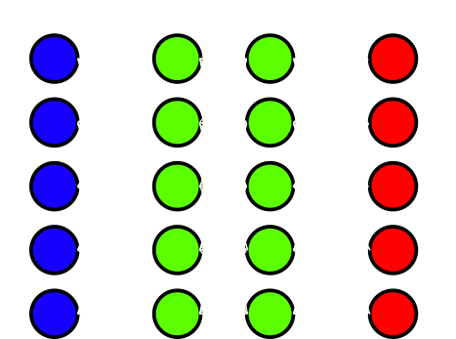
Important Concepts – Basic Structure
Think of it like a Graph!!!
A series of nodes (Outputs) connected to each other in Layers
Edges are Weights
Every layer that isn’t the actual data itself or the final layer are called Hidden Layers
A Classic Example!!!
Each node is connected to every other node
GRAPHS ARE DIRECTIONAL!!!
5 nodes per layer & 3 layers = 5 * 5 * 3 = 75
This is how many weights there are!!!
Equation is just a linear regression
Ans = w1i1 + w2i2 + w3i3 + w4i4 + w5i5
For all nodes in a layer
Ans + BIAS
Notes:
- Also, remember the activation function!!!
- Perceptron is a 1 layer version of an FFNN; produces a hyperplane relative to the graph.

Slide 13
Important Concepts – Back Propagation
Back Propagation is how neural networks learn on data
Like regular training data other machine learning models use (think Naive Bayes’!)
Train the model on batches of data over and over again until we “minimize the loss”
The Loss is how big the difference between the actual answers from the training data and the answers the model produced are!
You get the Loss from the Loss Function which measures the difference between the results and real answers
The Loss Function itself changes depending on task, model design, and other factors

Slide 14
Important Concepts – Encoding Data
There are many many many ways to encode data for a neural network
However, they all involve transforming the data into vectors (or matrix… but don’t worry)
Vectors are a series of numbers describing something (they also have direction & magnitude)
Ex. Dictionary = {‘hello’, ‘nice’, ‘meet’, ‘to’, ‘world’, ‘you’, ‘!’} Sentence = “hello world!” Sentence Vector = {1, 0, 0, 0, 1, 0, 1}
This type of encoding is called a One-Hot Vector because 1s represent what words are actually in the sentence compared to all the possible words we could have
Another popular way is just tokenizing the sentence in a specific way
Particularly used for Encoder-Decoder models and Transformers
Ex. “hello world!” -> [‘<s>’, ‘hello’, ‘world’, ‘<excl>’, ‘</s>’]
Changes from model to model; however, a start (‘<s>’) and end (‘</s>’) token are popular to include
Notes:
- You already learned about word vectors via TF-IDF and word2vec
- Can anyone see a problem with this when it comes to language processing?
- Sentence tokenization preserves word order

Slide 15
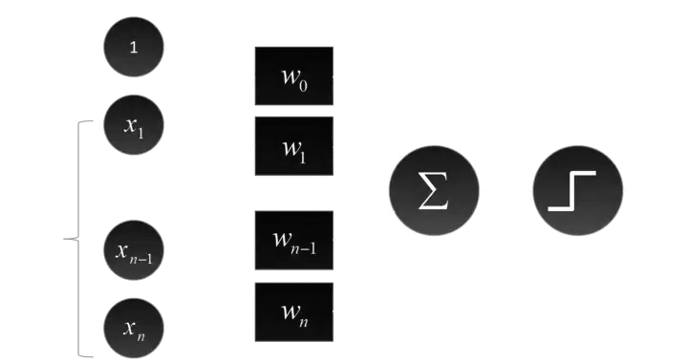
Important Concepts – Feed Forward Neural Networks
Feed Forward Neural Networks – The first and simplest type of neural model
Information is passed from the previous layer to the next directly, going forward through the graph
Simplest type Perceptron, every node in a layer n is connected once to every node in the previous layer n - 1, with there being only 1 layer in total
Notes:
- Can anyone see a problem with this when it comes to language processing?
- Sentence tokenization preserves word order

Slide 16
Important Concepts – FFNNs Cont.
Advantages:
Simple to understand and make
Easy to experiment with
Simple to train
Good learning tool
Disadvantages:
Its simplicity is also a bad thing
Terrible for complex tasks
Loss of information between layers
A given layer n only looks at the previous layer n-1’s information, nothing more, nothing less
Really bad at deterministic tasks
E.g. logic gates

Slide 17
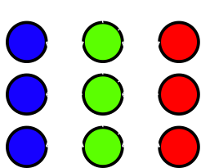
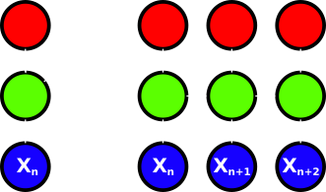
Important Concepts – Recurrent Neural Networks
Recurrent Neural Networks – Use previous information to affect the output
Recursively feed in the input to the result along its journey
Outputs from previous steps are included with the current step
Features Directionality – Can be either uni- or bidirectional
Notes:
- Note: the right image is the same three nodes but spread out over time!

Slide 18
Important Concepts – RNNs Cont.
Advantages:
More connectivity for less
“Remembers” certain things
Good neural network system to “add-on” to other neural models like convolutional networks
Disadvantages:
The vanishing/exploding gradients
The change to each weight either diminishes or increases rapidly
We get less improvement over time
Or we surpass it!
Long-Short Term Memory and Gated Recurrent Units attempt to solve these issues
Add priorities on what to remember
Notes:
- Why is exploding gradient bad?

Slide 19
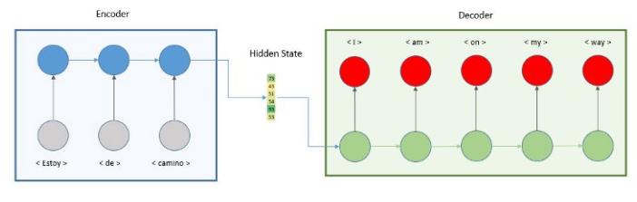
Important Concepts – Encoder-Decoder Models
Encoder-Decoder Models – A stack of RNNs produce a hidden state vector which is then fed into another stack of RNNs
It encodes the data and then decodes it later; the hidden state vector contains contextual information
Notes:
- This is great and all, but it is only unidirectional, only taking in the information it’s seen before as continued input. To get bidirectionality, we need to look at the whole sentence at once!

Slide 20
Important Concepts – Transformers
Remember June 12th, 2017?
On that day, several researchers at Google published a very famous paper that changed the field of neural networks and NLP
Attention Is All You Need
In this paper, the researchers propose a new neural architecture, called a Transformer
These are now the de facto standard for many NLP tasks like speech-recognition, question-answer finding, conversation agents, and also… machine translation!
Focus on this concept called Attention a mathematical model for taking in bidirectional context
Famous models: BERT, GPT-3, T5, etc.
BERT in particular has many offshoots: RoBERTa, ALBERT, DeBERTa, etc.

Slide 21
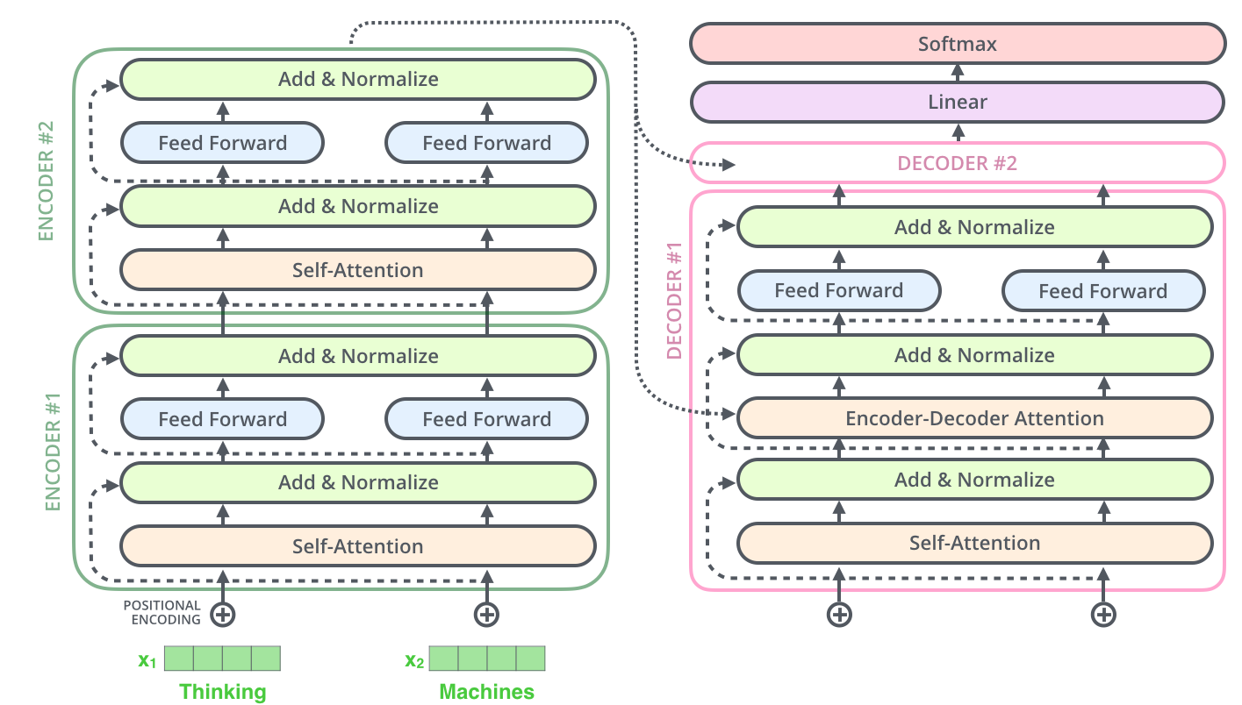
Important Concepts – Transformers Cont.
Notes:
- Mention that there are encoding and decoding layers
- Stores bidirectional information and context
- Computationally very expensive

Slide 22
Important Concepts – Why Neural Networks?
Transformers are now a de facto approach because they work
More data = better results*
They’ve performed the best compared to statistical and rule-based translation
Before transformers, Encoder-Decoder and RNNs were the common models used
They have a wide-range of uses and can be adapted to many NLP tasks
Even in producing vectors for the models! (BERT word embeddings)
Notes:
*Results may vary and we need to consider things like model bias and the exploding/vanishing gradient problem
- More training is not always better (over fitting) and can result in an increased loss value!

Slide 23
Important Concepts – Why Not Neural Networks?
Computationally very expensive
Pretrained: Transformer models can be trained on “general data” for a generalized task
NLP tasks, computer-vision tasks, etc.
Fine-Tuning: Taking these pretrained models and training them more to a specific task
Less training than training from scratch with similar results
Hyperparameters: The weights, biases and other factors (e.g. parameters) inside the model
Random & Grid Search: Techniques to try to find the best hyperparameters for a task
The bigger the model, the smaller our understanding
Transformers especially are considered “blackboxes”
This makes things like bias detection/removal hard
Lots of data and big models can take weeks to train
Pathways Language Model (PaLM) by Google has 540 BILLION parameters!
Notes:
- PaLM was just recently created

Slide 24
Important Concepts – Interesting Developments
Machine translation for low-resource languages
Low-Resource just means small amounts of data
Speech-to-text (STT) systems for code-switched dialogue
Code-Switched: Speaker(s) switching between languages during a conversation
Improving the size and scalability of pretrained models
Make them smaller, more efficient, and more adaptable to a wider variety of tasks
Notes:
- PaLM was just recently created

Slide 25
Public-Facing APIs

Slide 26
Public-Facing APIs – SKLearn, PyTorch & Hugging Face
Scikit Learn is an extremely popular package for learning about and making machine learning models
Has a wide variety of features and models to use and choose from
Despite it being a learning kit, I’ve seen it used in actual research
PyTorch is a Python package designed to make various neural network models
More complicated than Scikit Learn, but they can work together
Handles the complicated things like the math and the training, but is still extremely flexible
Similar packages are Google’s TensorFlow and Keras
Hugging Face is a website and a group of Python Packages
Contain interfaceable pretrained transformer models and various measurement metrics
Notes:
- PaLM was just recently created

Slide 27
References & Useful Sources
https://github.com/AlejandroCiuba/Tamasheq-English-French
https://www.youtube.com/watch?v=QNBuK9ZNo_0
https://github.com/AlejandroCiuba/Tamasheq-English-French
http://ec2-18-219-160-46.us-east-2.compute.amazonaws.com/~narae/vault/ling1330-2021/Guest_Lecture_on_Machine_Translation.pdf
https://en.wikipedia.org/wiki/L%C3%A9on_Dostert
https://en.wikipedia.org/wiki/Neural_machine_translation
https://en.wikipedia.org/wiki/Google_Neural_Machine_Translation#:~:text=In%20November%202016,%20Google%20Neural,,%20in-house%20SMT%20technology.
https://en.wikipedia.org/wiki/BLEU
https://towardsdatascience.com/foundations-of-nlp-explained-bleu-score-and-wer-metrics-1a5ba06d812b
https://en.wikipedia.org/wiki/Word_error_rate
https://towardsdatascience.com/what-the-hell-is-perceptron-626217814f53
https://towardsdatascience.com/activation-functions-neural-networks-1cbd9f8d91d6
https://en.wikipedia.org/wiki/Feedforward_neural_network
https://en.wikipedia.org/wiki/Feedforward_neural_network
https://en.wikipedia.org/wiki/Feedforward_neural_network
https://www.youtube.com/watch?v=aircAruvnKk&t=915s
https://www.techtarget.com/searchenterpriseai/definition/recurrent-neural-networks
https://www.geeksforgeeks.org/introduction-to-recurrent-neural-network/
https://www.ibm.com/cloud/learn/recurrent-neural-networks
https://towardsdatascience.com/illustrated-guide-to-lstms-and-gru-s-a-step-by-step-explanation-44e9eb85bf21
https://towardsdatascience.com/what-is-an-encoder-decoder-model-86b3d57c5e1a
https://arxiv.org/abs/1706.03762
https://jalammar.github.io/illustrated-transformer/
https://www.topbots.com/leading-nlp-language-models-2020
https://www.youtube.com/watch?v=ftWlj4FBHTg
https://towardsdatascience.com/transformers-the-bigger-the-better-19f39f222ee3#:~:text=The%20largest%20model%20so%20far&text=This%20latest%20model%20from%20Google,%2FNVIDIA%20Megatron-Turing%20NLG.
https://scikit-learn.org/stable/
https://huggingface.co

